Slide 1
Intelligent Transportation Systems: Real-Time Data
Chris.Lambert@ky.gov

Slide 2
Need for Change
2014 Title 23 CFR 511.301-315
10/20 Minutes Timeframe
Road and/or Lane Closures
Roadway Weather and/or Environmental Conditions
Travel Times or Speeds
Data Accuracy of 85%
Data Availability of 90%
2013-2014 Winter: $78mil and salt shortage
2014 Waze Connected Citizens Program
2014-2015 Winter: $68mil and I-65 shutdown
2015-2016 Winter: $56mil and I-75 shutdown
Notes:
2014 was a big year…
By comparison, the 2012-2013 and 2015-2016 winters only cost $40-$45 million.
Even though the regs speak mainly to interstates and “routes of significance”, we’re going to apply the same standards to all state routes.
Waze really challenged us to think differently about real-time data.

Slide 3
Software and Data Mashup
ArcGIS Online
Python Language
Kafka
Spark
Elasticsearch
Hadoop
Currently processing 15-20mil records per day.
Waze
KYTC Snow Plows
Twitter / Social Media
HERE Traffic
KYMesonet Air Temps
KYTC RWIS Pavement Temps
CoCoRahs Precipitation
Notes:
Here is a quick list of our software stack and some of the more popular pieces of data that we’re mashing together.
I’m going to try getting through all of these data sources.

Slide 4
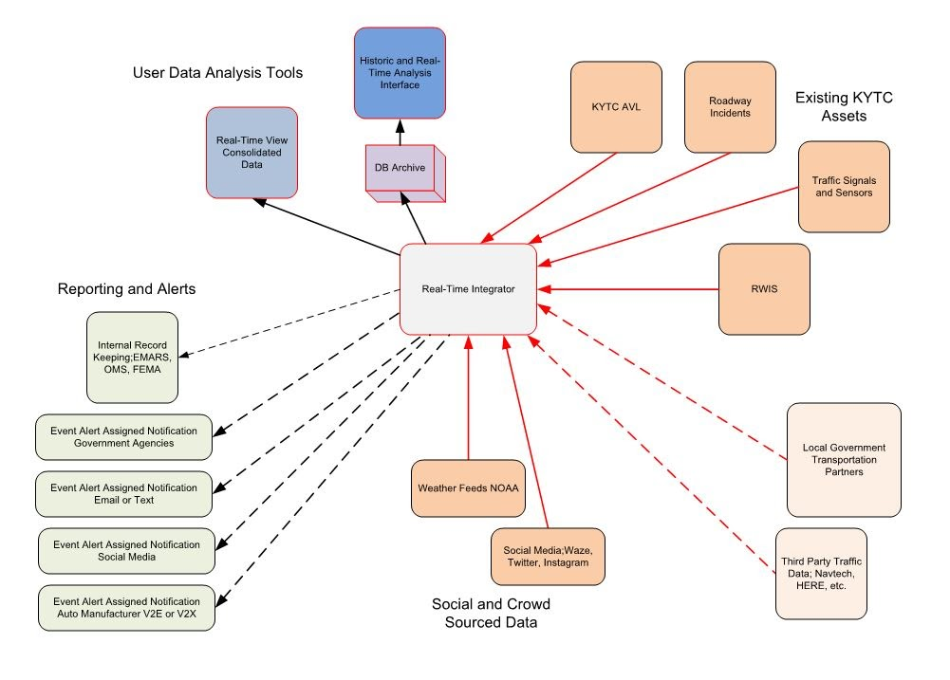
Notes:
And here is a quick visual of the data flow. With the ability to pull and push data to and from multiple platforms, the possibilities are endless. We can now directly communicate with cars, people, and infrastructure.

Slide 5
Weather Data
RWIS/KYMesonet
District Averages the County
County Searches for Nearest
Set to 1 hour increments in Summer
Set to 5min increments in Winter
CoCoRahs Snowfall Data
Certified reporters submit snowfall between 5a-10am
KYTC updates every 24 hours.

Slide 6
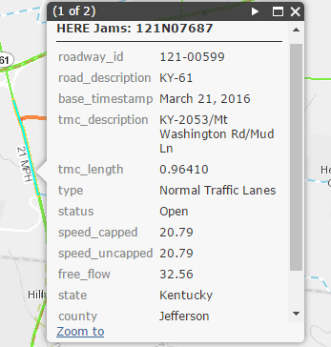
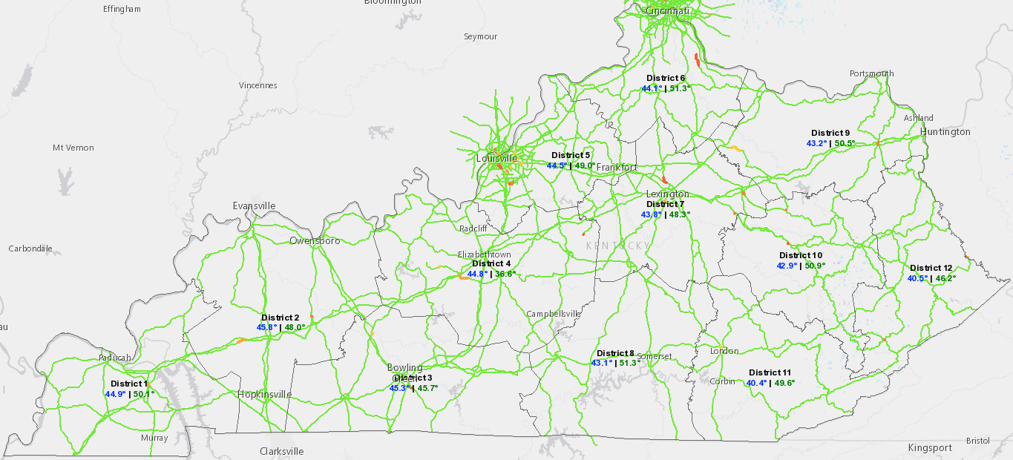
Notes:
We license HERE Traffic data. It serves as the anchor for everything else that we do. All of the other data sources can be compared or measured against HERE.

Slide 7
HERE Data
TMC Number
Roadway ID
Road Description
Base Timestamp
TMC Description
TMC Length
Type (such as “Normal Traffic Lanes”)
Status (such as “Open”)
Speed Uncapped
Free Flow
Jam Factor
Confidence
State
County
Direction
RT_Unique
Year
Month
Day
Weekday

Slide 8
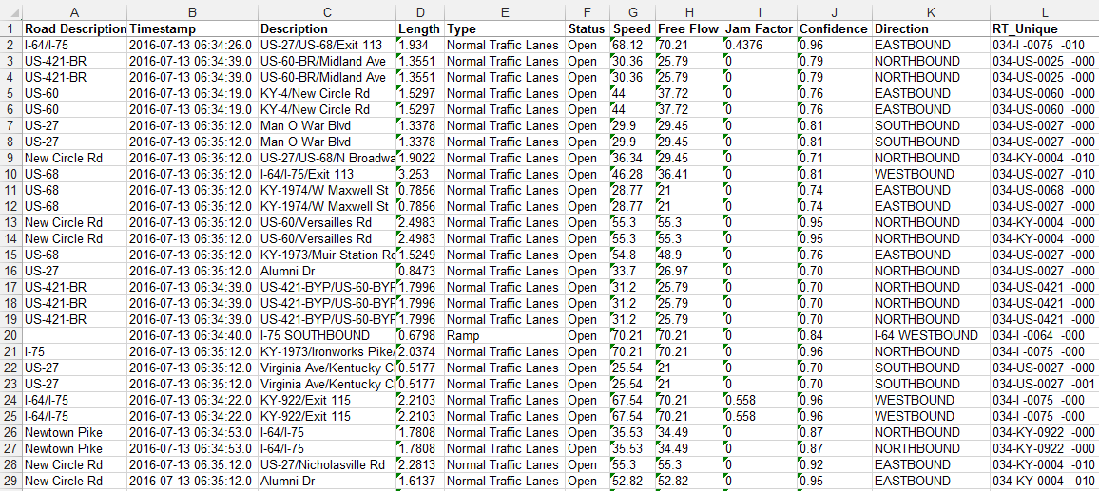
HERE Data
Notes:
We have several extra columns that are not displayed.

Slide 9
Video
Notes:
Kentucky was one of the first organizations to join the Waze Connected Citizen’s Program.
Our official launch was October 2014.
Kentucky has been on the agenda twice since then for the Global Waze Summit.
https://www.youtube.com/watch?v=pcb8IYvOXDc&feature=youtu.be

Slide 10
Notes:
How does it all work? Explain the data exchange. We receive data every 2 minutes. We provide a feed to Waze that allows them to consume our data at their convenience.

Slide 11
Notes:
INPUT
So what data do we receive? Emphasis on the fact that we do NOT receive personal information; nor do we receive police officer locations.
We receive two types of data: GPS generated traffic jams and User reported incidents.
Jams are extremely reliable and incidents can be subjective.
Incidents allow us a view of the driver’s perspective though.

Slide 12
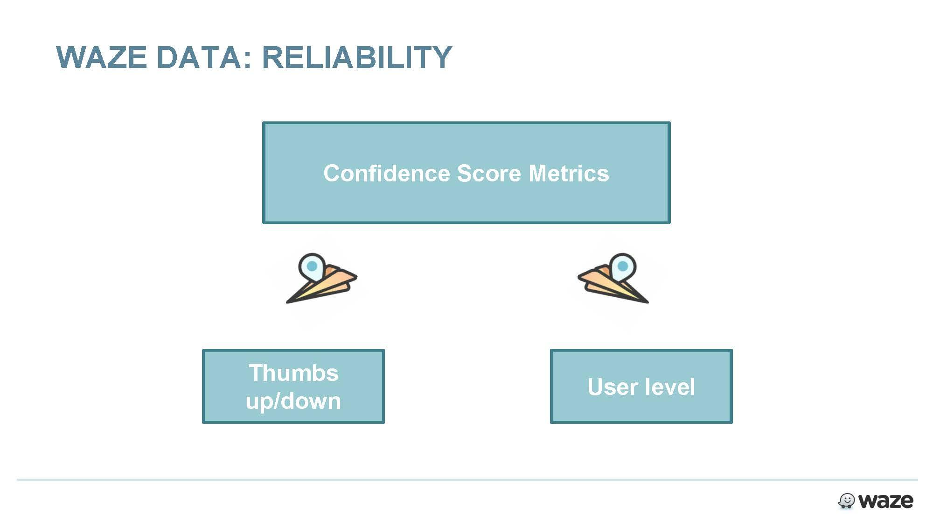
Notes:
I get this question all of the time…. How reliable is it?
Explain the scores.
Remember to talk about Government IDs here!!

Slide 13
Waze: Incident Data
X, Y Coordinates
Type/Subtype
Date
Time
County, City
Roadway Type
Street Name
Heading
User Rating
Reliability Rating
Description
RT_Unique
District
County
Route
Mile point
Year
Month
Day
Weekday

Slide 14
Waze: Traffic Jams
Multiple X, Y Coordinates
Delay
Date
Time
County, City
Roadway Type
Street Name
Length
RT_Unique
District
County
Route
Beginning Mile Point
Ending Mile Point
Year
Month
Day
Weekday

Slide 15
Social Media

Slide 16
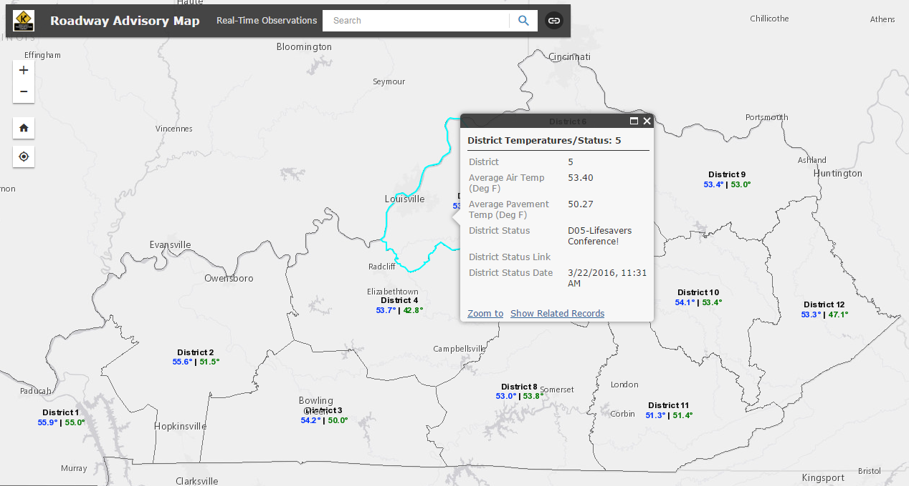

Slide 17
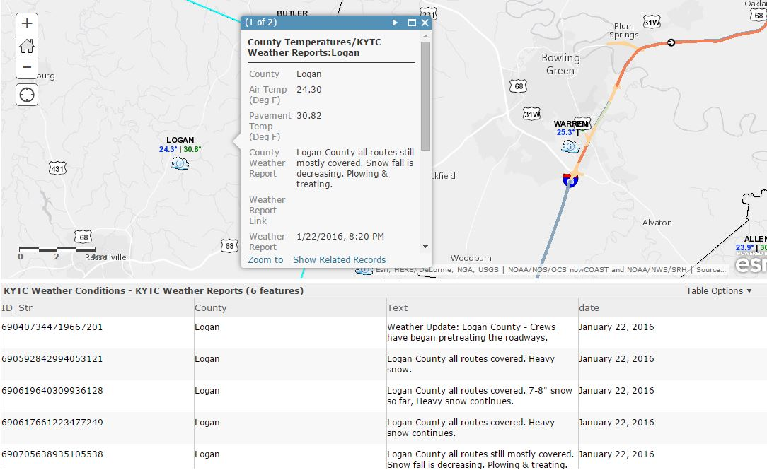
Notes:
Researching past tweets to create a timeline.

Slide 18
Social Media
X, Y Coordinates
140 characters of text
Links to photos
Date
RT_Unique (if applicable)
District
County
Route
Mile Point (if applicable)

Slide 19
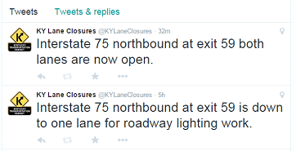
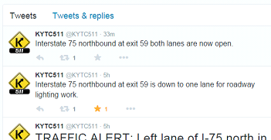
I-75 Pilot: District 11
Press Release
Tweet closure within 20min
Tweet opening within 20min
Notes:
Capturing tweets in the database.

Slide 20
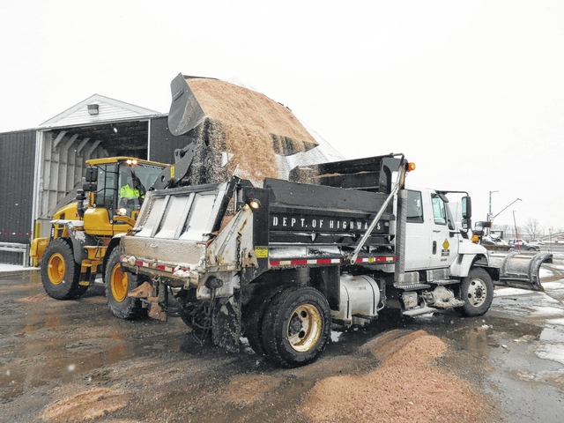
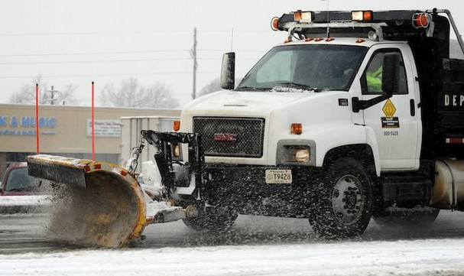
KYTC Snow Plows

Slide 21
KYTC AVL (Snow Plow)
X, Y Coordinates
Velocity (MPH)
Direction
Date
Year
Month
Day
Hour
Minute
Second
Plow Status
Dry Rate
Liquid Rate
RT_Unique
Road Name
Route
County
District
Begin/End Mile Point
Dry Cost
Liquid Cost
Event Name

Slide 22
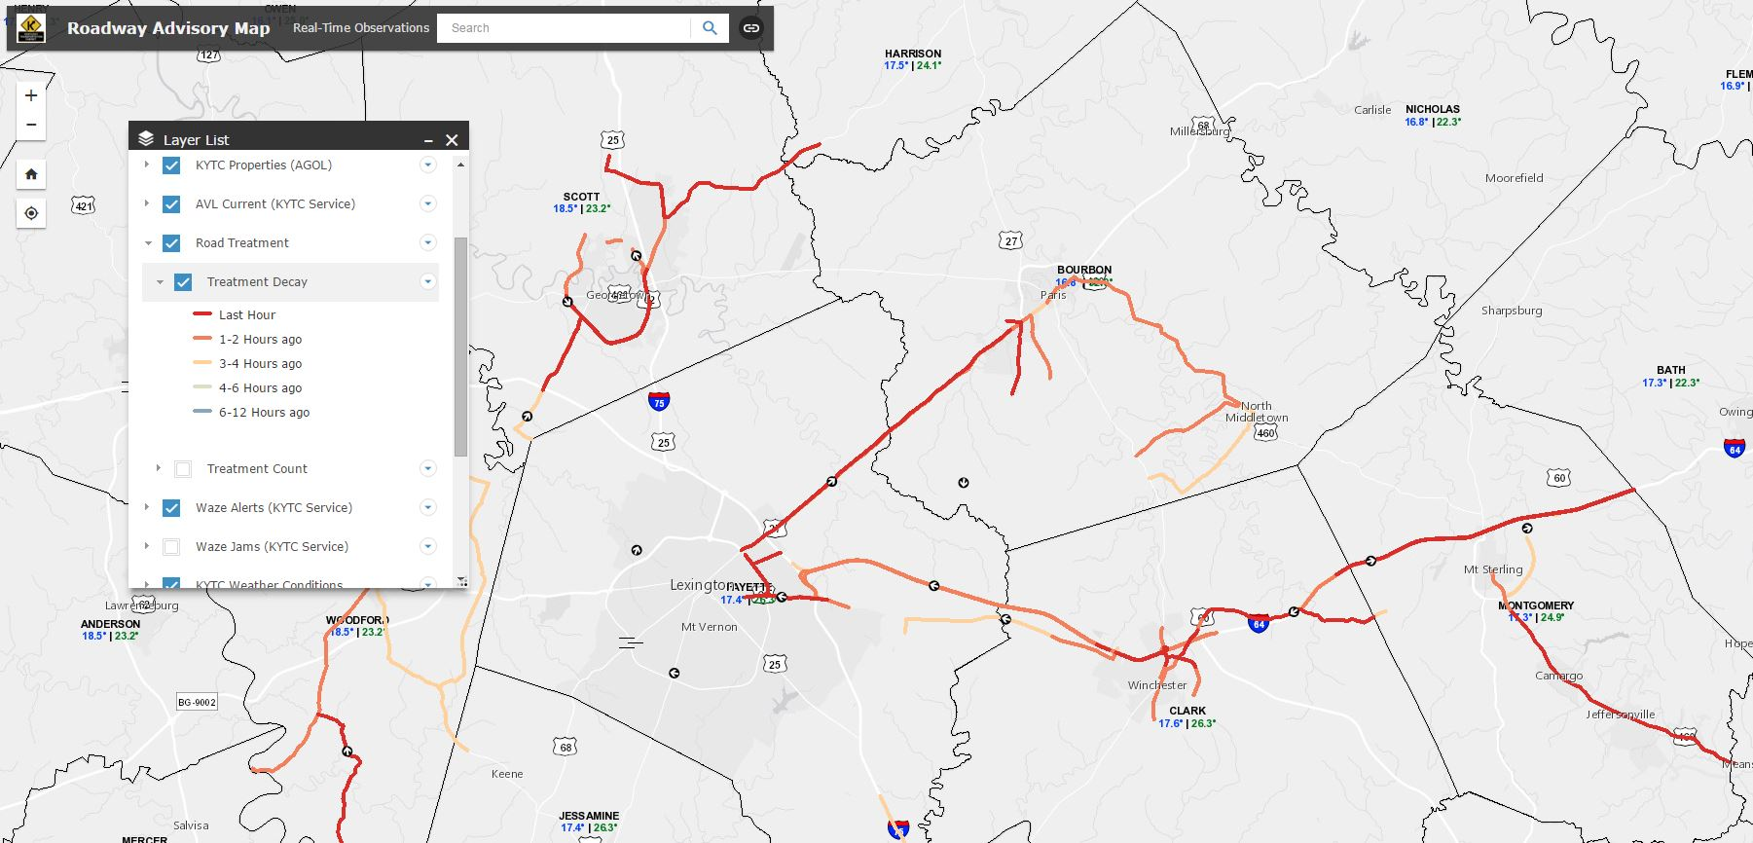
Notes:
Weather - AVL Treatment Decay Layer

Slide 23
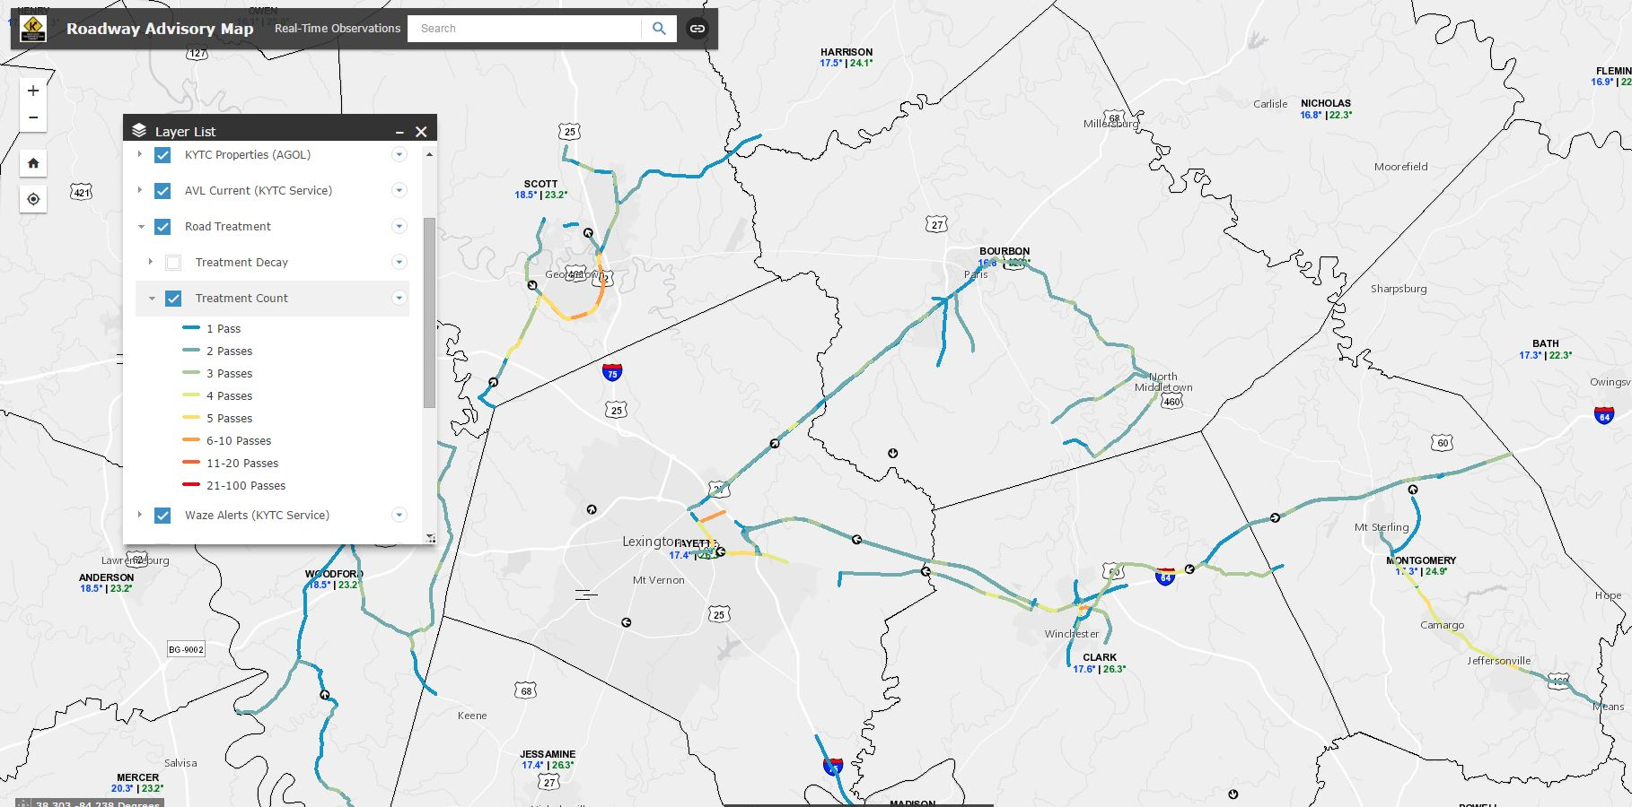
Notes:
Weather- AVL Treatment County Layer

Slide 24
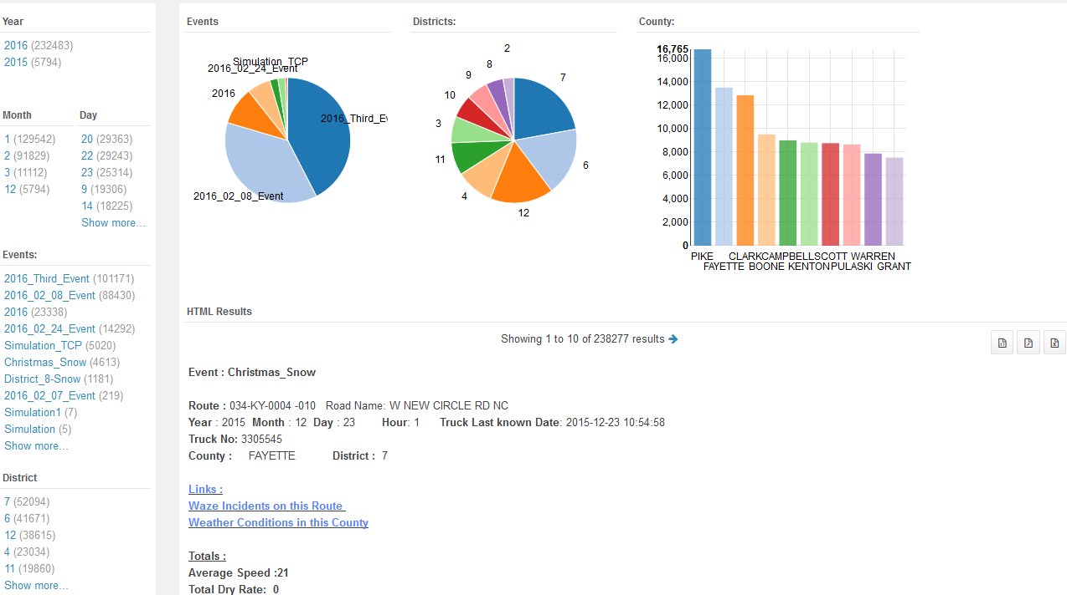
Chris.Lambert@ky.gov | http://transportation.ky.gov/realtime

Slide 25
Incident Review

Slide 26
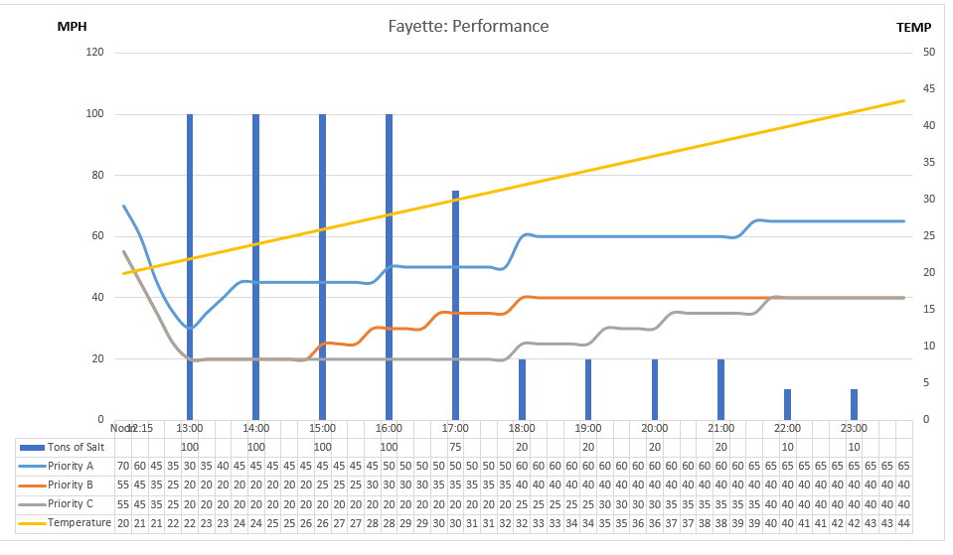

Slide 27
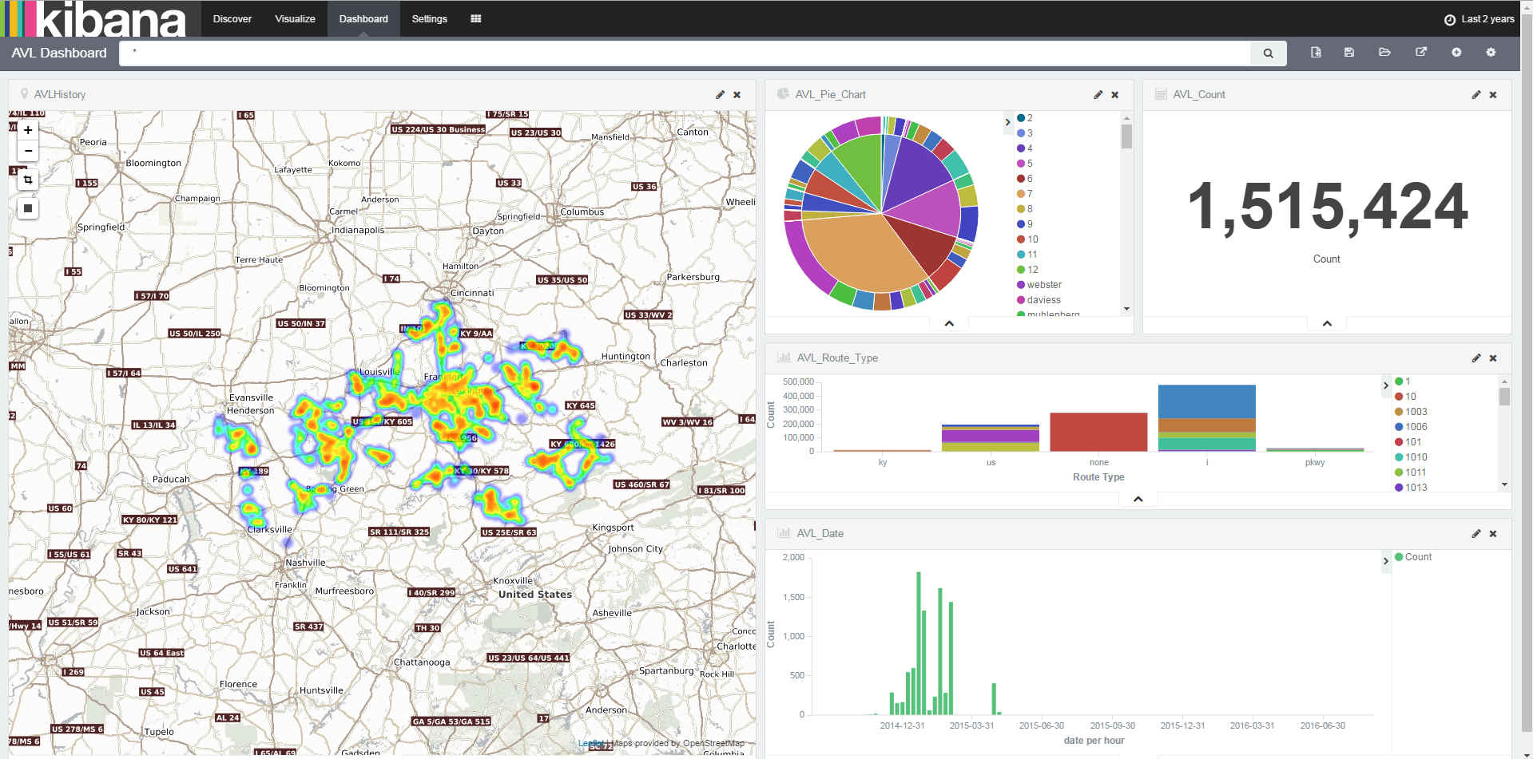

Slide 28
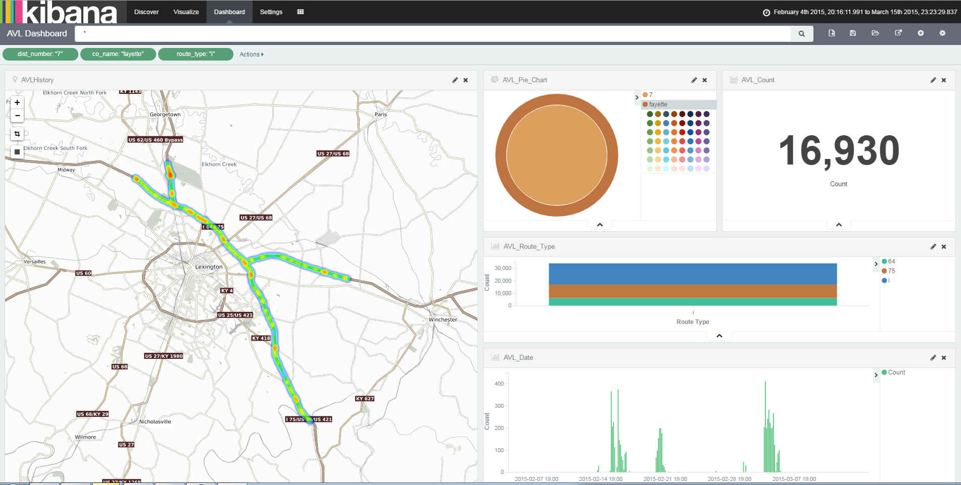

Slide 29
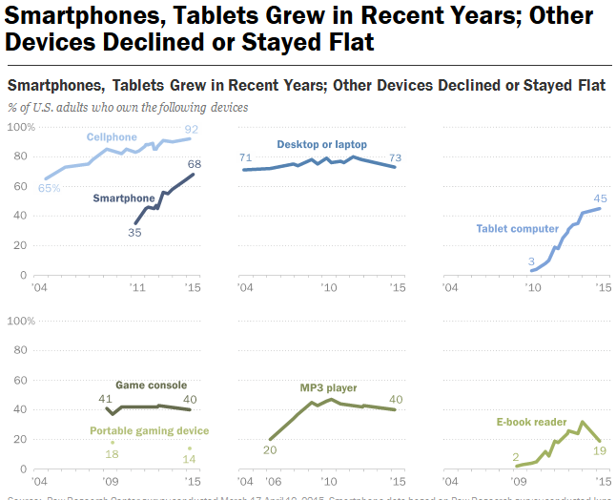
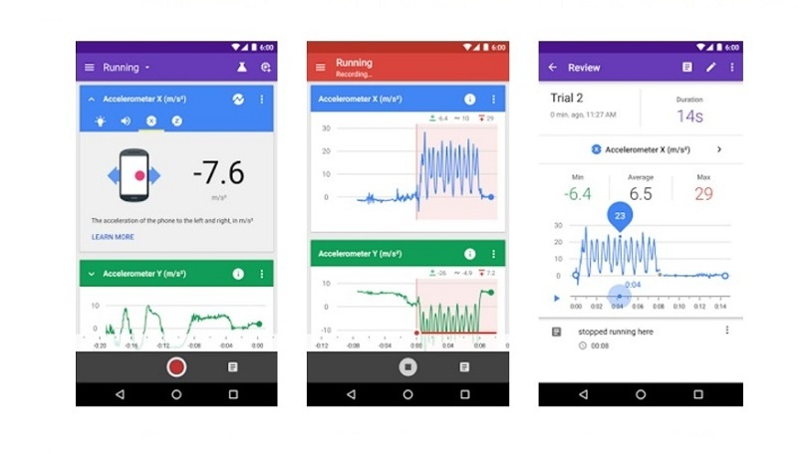
Rising Expectations
Google Science Journal

Slide 30
Question & Comments
Chris.Lambert@ky.gov, ITS/Waze
Jeremy.Gould@ky.gov, GIS
Vineet.Kumar@ky.gov, Hadoop/Spark

